Slide 1
YouTube Data Analysis in Hadoop MapReduce Environment
INFERNO
Arpit Mathur
Senthamil Sindhu
Vimarsh Deo

Slide 2
Group project Description
YouTube allows billions of people to connect, inform, and inspire others across the globe using originally created videos.
In our Project we analyze the data to identify the top 5 categories in which the most number of videos are uploaded.
The dataset will be gathered using the YouTube API and stored in Hadoop Distributed File System(HDFS)
MapReduce algorithm will be applied to process the dataset and identify the video categories.

Slide 3
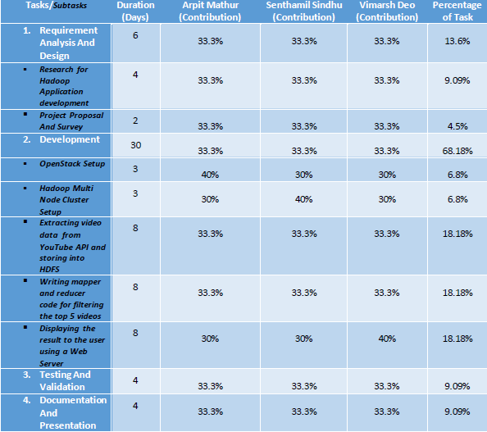
Project Description (cont.)
Tasks allocation

Slide 4
Technical Details
Software
  YouTube API
  Apache Hadoop 2.0
  Java, PIG, HIVE, HTML, CSS
  Ubuntu 16.04 LTS
Hardware
  Thoth Lab Infrastructure

Slide 5
Technical Details
Project Setup

Slide 6
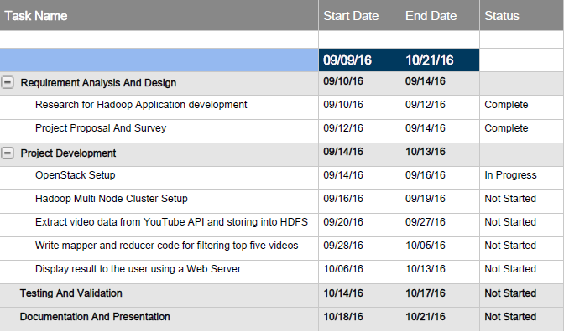
Technical Details
Project Milestones

Slide 7
Risks and Benefits
Novel aspects of this project:
  This application can help YouTube understand the top most trending topics.
  Test and classify videos on real time data.
Risks/challenges:
  Crawling large amount of datasets using YouTube API on various search queries.
  Setting up Hadoop cluster with Openstack.
Potential applications & benefits:
  Transforming these data into decisions which has good impact on the real world.
  Develop a scheduler to crawl the data every week and analyze the data to show week wise hot topics.

Slide 8
Tasks Accomplished by Now
1st Draft of the Project Proposal completed.
Setting up Openstack.
Learnt how to setup multi-node Hadoop Cluster in Ubuntu.

Slide 9
Conclusion
This project enables us to analyze trending topics and interests of people through social networking forum.
We have done data analysis on a single YouTube dataset. Future work can be done by doing the same analysis on weekly gathered data to identify the current trending topics and area of interest of the mass.
Future work also includes transforming these data into decisions which has good impact on the real world.

Slide 10
Thank You

